Slide 1

Poster session
Aortic dissection during pregnancy
E.Hamza, H.Benjemaa, M.Gueldich, A.Lasmar, M.Rebai, W.Jaouedi, G.Barkallah, A.Dammak, I.Frikha.
Department of cardiovascular and thoracic surgery Habib Bourguiba Hospital Sfax Tunisia
17th Afro-European practical cardiology meeting
September 3-5,2020 Sousse Tunisia .
** Academic Editor: Dr Ilhama Jafarli

Slide 2
Observation
38-year-old female , G3/P3, no previous history, 36th week of pregnancy
Severe chest retrosternal pain since 2 days
Normal chest Xray P/A and D-Dimer
ECG : no repolarisation abnormalities
TTE : normal VG function, severe aortic regurgitation , AAo at 47mm with intimal flap and mild pericardial effusion
Angio-CT confirmed the dissection of the the ascending aorta (AAo)

Slide 3
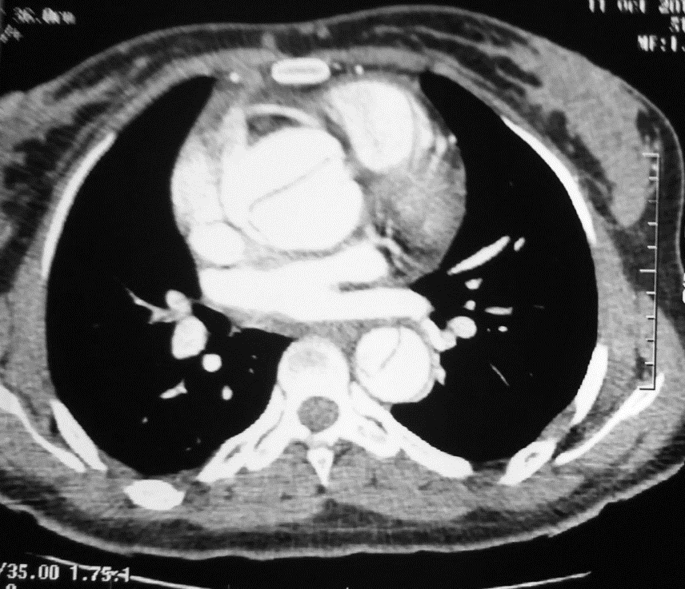
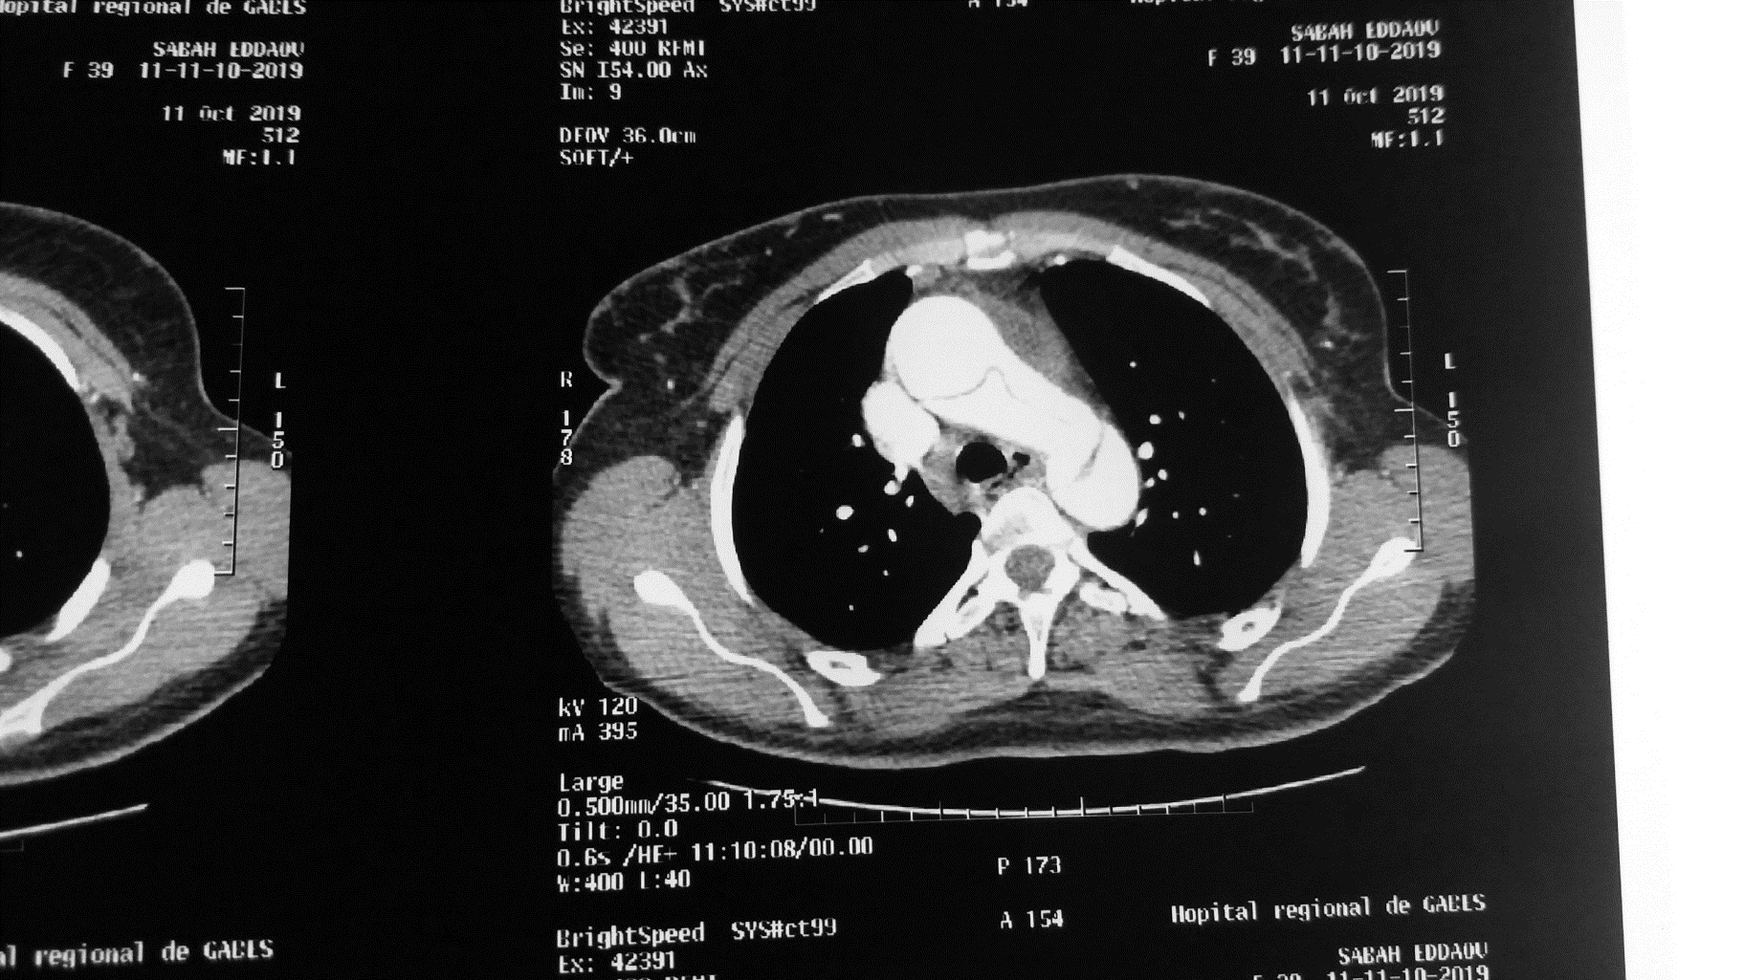
Observation

Slide 4
Observation
Lung maturation ,emergency C/S baby normal examination, persistant bleeding due to placenta accreta hysterectomy.
Bentall procedure
-sternotomy
-cardio-pulmonary baypass
-left ventricular discharge through right superior pulmonary vein
-warm blood selective blood cardioplegia and moderate general hypothermia
-Aortic valve replacement and ascending aorta prosthetic graft replacement with coronary arteries reimplantation.

Slide 5
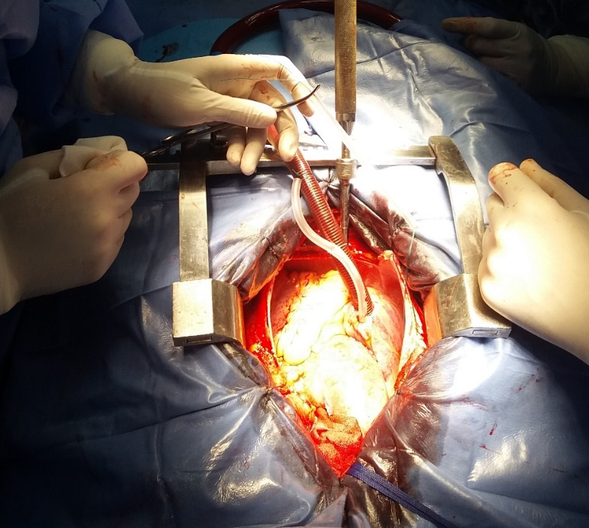
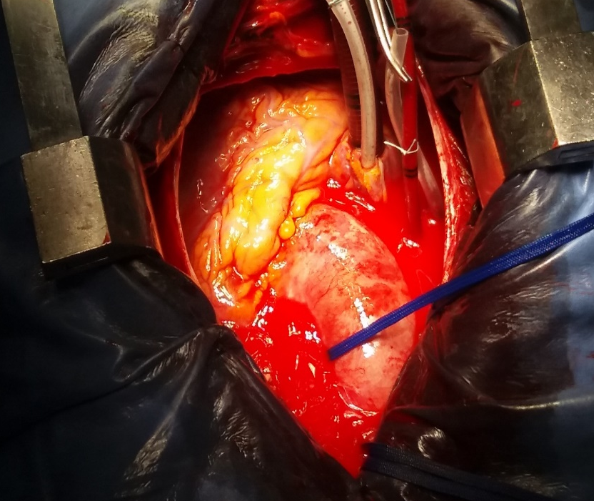
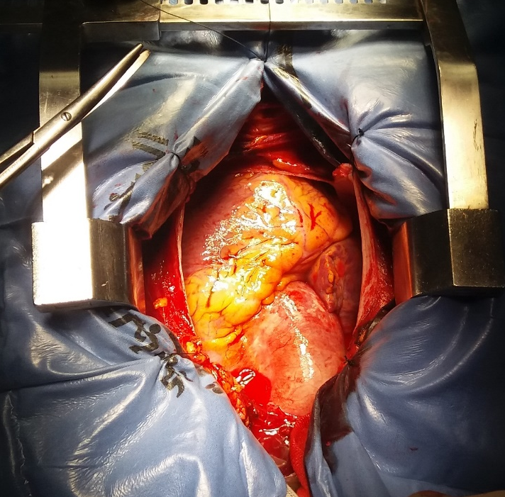
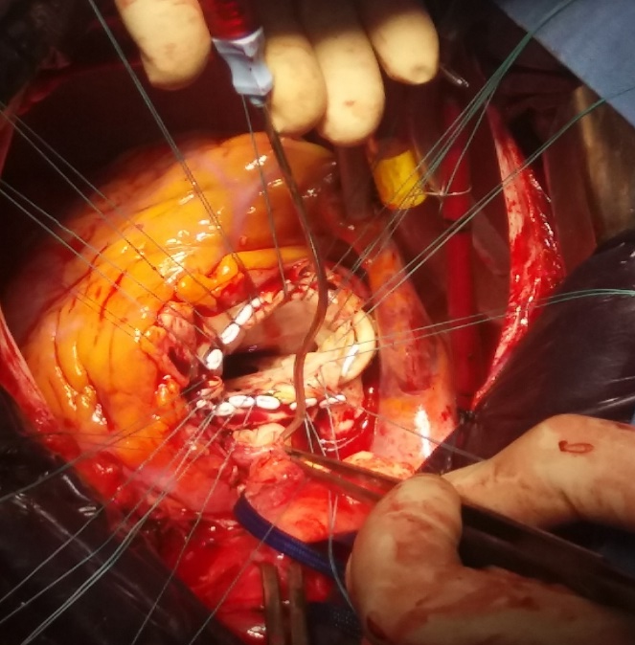
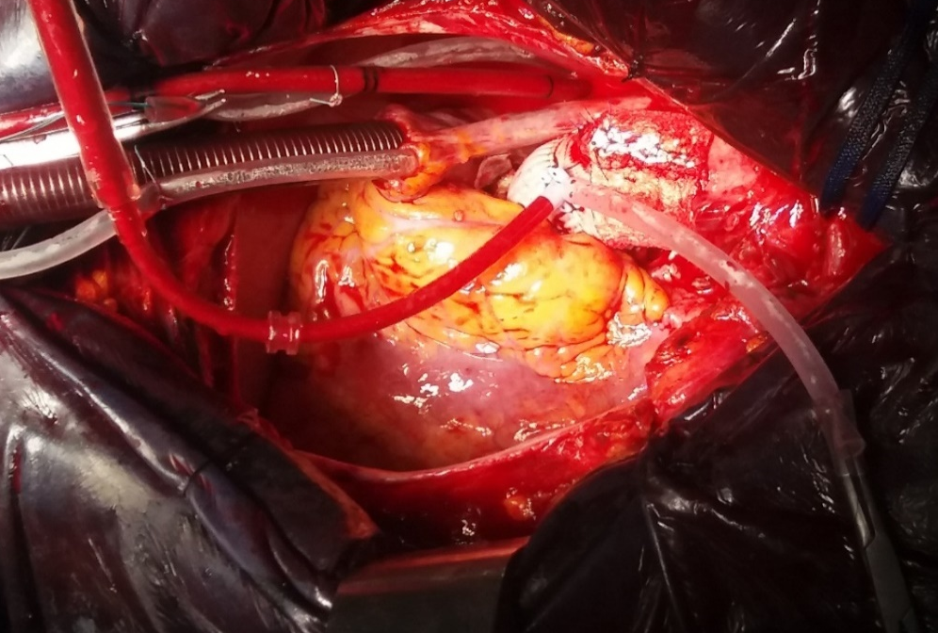
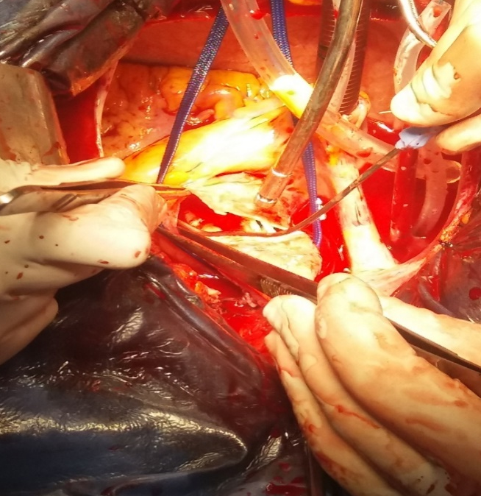

Slide 6
Observation
postoperative course
- right pleural effusion drained
- segmental pulmonary embolism
- discharged day 15 post procedures
- histopathology negative for Marfan disease

Slide 7
discussion
The incidence aortic dissection (AoD) during pregnancy is 14.5/1000000 with 30 to 50 % fetal and maternal mortality.
AoD is frequent in patients with connective tissue disorders such as Marfan or Ehlers-Danlos syndrome [1].
Pregnancy-related changes in vascular wall could contribute to this complication.
Dissection accure usually in the 3rd trimester of pregnancy. The risk of AoD remains high in the post partum [2].
AoD in pregnancy is Type A (ascending aorta) in 90% of cases.
The symptoms are non-specific AoD to be evoked in predisposd patients.
The management of AoD is surgical.
Heparinization and hypothermia could lead to delivery complications [3].
The management has to be multidisciplinary.

Slide 8
References
[1] Poniedzialek-Czajkowska E, Sadowska A, Mierzynski R, Leszczynska-Gorzelak B. Aortic dissection during pregnancy - obstetric perspective. Ginekol Pol. 2019;90(6):346-350.
[2] Kamel H, Roman MJ, Pitcher A, Devereux RB. Pregnancy and the Risk of Aortic Dissection or Rupture: A Cohort-Crossover Analysis. Circulation. 2016 Aug 16;134(7):527-33.
[3] Yuan SM. Aortic dissection during pregnancy: a difficult clinical scenario. Clin Cardiol. 2013 Oct;36(10):576-84.

