Slide 1

Poster session
Lyme Disease: A rare cause of complete atrioventricular block.
Hassen Ibn Hadj Amor, Skander Bouchnag
Department of cardiology Tahar Sfar Hospital Mahdia Tunisia
17th Afro-European practical cardiology meeting
September 3-5,2020 Sousse Tunisia .
** Academic Editor: Dr Ilhama Jafarli

Slide 2
Observation
44 year old female with no past medical history
Presented to ER for persistent dizziness and recurrent pre-syncope for the last 5 days
The cardiac auscultation was normal BP120/75
PR 34
ECG: Third degree atrioventricular block

Slide 3
Observation

Slide 4
Observation
The patient was hospitalized
Isoprenalin IV stabilized the PR at 60bpm
First laboratory investigations showed only severe lymphopenia at 920
TTE: no structural or functional abnormalities.
Immunological investigations was negative of vasculitis, SL and rheumatoid arthritis
A biopsy of the salivary gland showed no abnormalities
Hepatitis B , C and A : negative serology

Slide 5
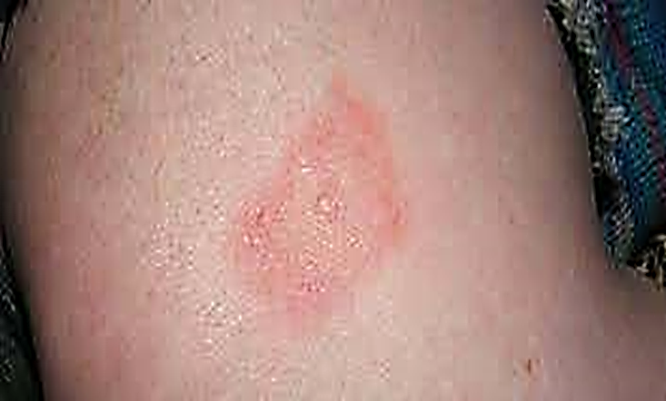
Observation
This patient living in rural area reported joint and muscle pain following a tick bite in her left arm 15 days ago with an erythema of a spontaneous resolution
Lyme disease suspected Serology:positive
the patient underwent an antibiotherapy for 4 weeks
Normal cardiac rythm was obtained since the first 10 days

Slide 6
Discussion
Lyme disease is bacterial infection caused by Borrelia burgdorferi and rarely Borrelia mayonii
Transmitted to humans through the bite of infected blacklegged ticks.
Typical symptoms include fever, headache, fatigue, and a characteristic skin rash called “erythema migrans”. Serology can be negative [1].
untreated, the infection can spread to joints, the heart, and the nervous system.
Lyme carditis is challenging diagnosis [2]
Lyme disease could be treated only on objective suspicion in some situations [3].

Slide 7
References
[1] Wan D, Baranchuk A. Lyme carditis and atrioventricular block. CMAJ. 2018;190:E622.
[2] Pilypas AA, Raišelienė G, Valaikienė J. Lyme disease and heart transplantation: presentation of a clinical case and a literature review. Acta Med Litu. 2019;26:173-80.
[3] Riaz S, Garel A, Subedi A, Mogadam E, Weinberg A. Third-Degree Atrioventricular Block as the Initial Presentation of Lyme Disease. Cureus. 2020;12:e9574.

